Slide 1
AirBnB Prices in Vienna
Data Analytics Group Assignment – Group B3

Slide 2
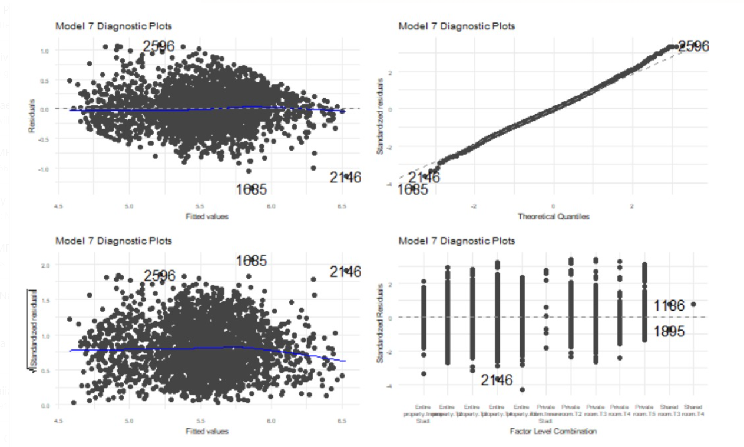
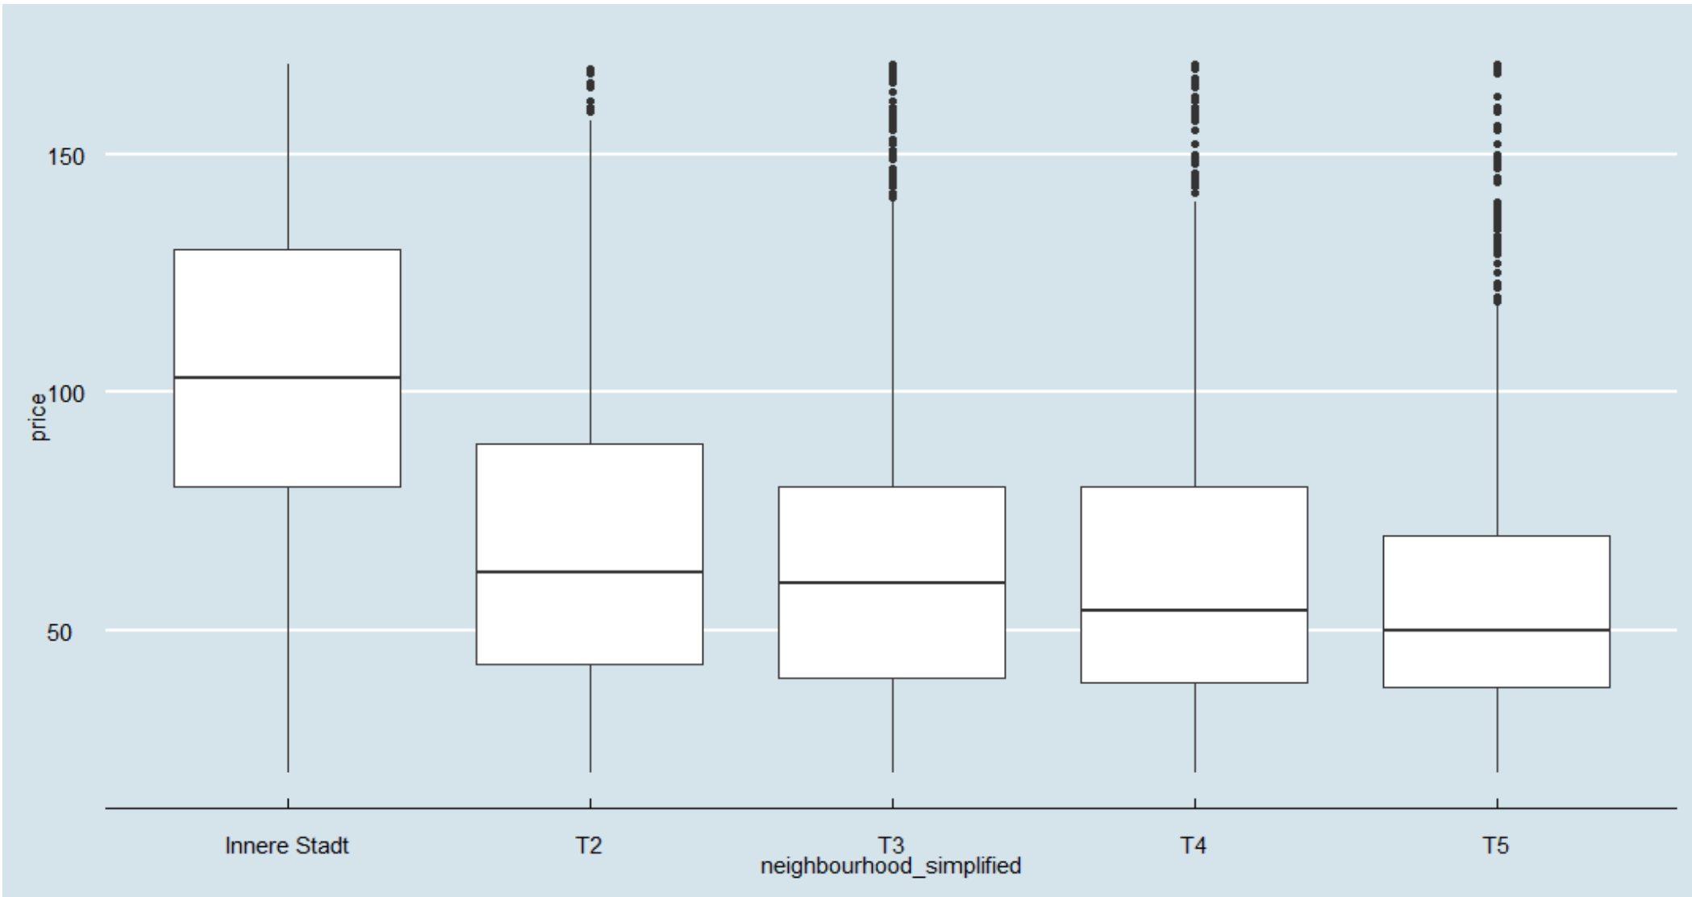

Executive Summary
Model resulting from Analysis
Key aspects
Data wrangling and property types
Reduced listings to 39% of raw data, filtering for NA values and outliers in prices, number of reviews and minimum nights
Classified listings into four property types
Exploratory data analysis
Explored if distance to city center directly impacts price, with no clear indication
Classified listings into five tiers, each consisting of up to five districts
Adjusted R squared of 51.65% with p of < 2.2 e⁻¹⁶
Variables used for model: Room types, tier of neighborhood, review scores, accommodates, bathrooms, host is superhost and availability
Correlation analysis
Indication hat multicollinearity in regression has to be considered
Some correlations might be conditional on the value of a categorical variable
Using seven variables the optimal model entails an adjusted R² of >50%

Slide 3
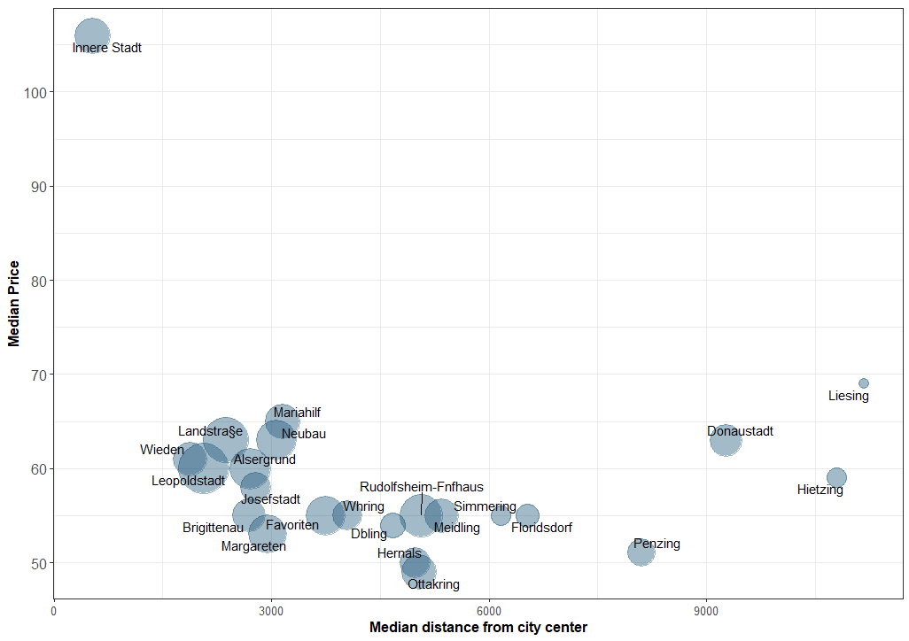
Exploratory Data Analysis
Relation price and distance from center¹
Classification of areas into tiers
1010 with least median distance to center, leading to highest median prices
However, no clear relation, as some of most expensive areas are far from center
It appears that districts can be separated into 5 tiers, with 1010 entailing the highest median price
Distance from city center on stand-alone basis does not indicate price levels, however tiers being more meaningful

Slide 4

Data Wrangling
Filtered the data based on log price in order to remove NA values and outliers
Outliers defined as prices outside the 90% interval, corresponding to 20 € and 90 €
Data Wrangling
Property Types
Property types [T 15]
Share
Entire rental unit
65.8%
Raw data
Private room in rental unit
18.1%
Entire condo
4.6%
Property types used
Share
Entire serviced apartment
2.8%
Prices
8%
Entire loft
1.5%
Entire rental unit
65.8%
Private room in resid. home
1.0%
Filtered the data set so that it only includes observations with minimum nights <= 4
Private room in condo
0.9%
Private room in rental unit
18.1%
Number of nights
15%
Entire residential home
0.8%
Room in hotel
0.6%
Filter out listings with < ten reviews
Room in boutique hotel
0.5%
Entire Apartment
8.8%
Private room in B&B
0.5%
Reviews
Private room in hostel
0.4%
Other
7.4%
Shared room in rental unit
0.4%
Room in serviced apartment
0.3%
Result
Room in aparthotel
0.2%
Other
1.8%
Total
100%
39% of listings (8,844) used
Condensed to four property types

Slide 5
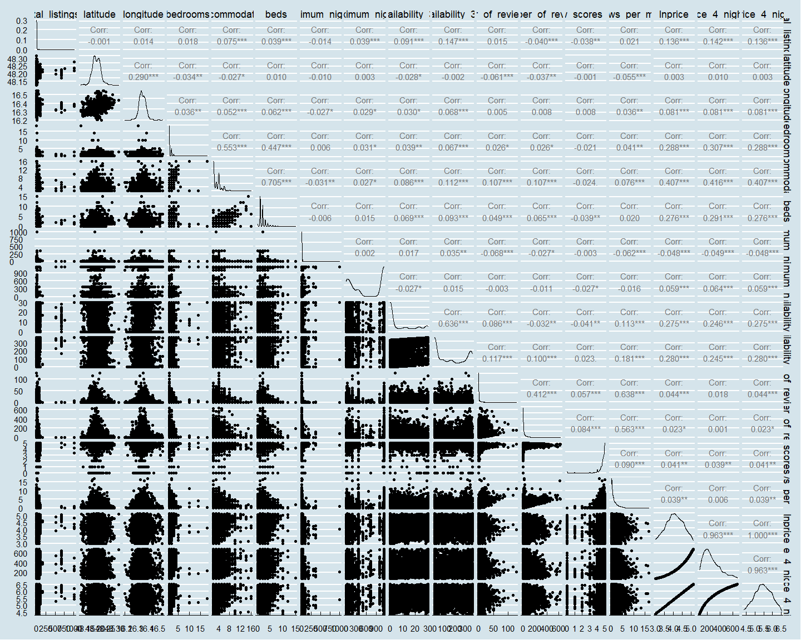
Correlation Analysis
Correlation of variables
Observations
PLACEHOLDER FOR GRAPH
1
Many variables with high correlation with each other, eg. beds and accommodates
We need to consider multicollinearity in regression
1
2
Some scatterplots cannot support a linear relationship between variables, eg. price and total listings of the host
3
There could be some correlations conditional on the value of a categorical variable
E.g. correlation between price and bedrooms might be conditional on property / room type, (listing of entire or single room might influence the number of bedrooms)
2
3

Slide 6
Model Used
Model resulting from Analysis
Used variables
Estimate
Room types
Hotel Room, Private room, and Shared room
(0.6) – (0.4)
Neighbourhood
Classified in tiers Innere Stadt, T2, T3, T4 and T5
(0.2) – 0.4
Review scores
Among the most impactful
0.3
Accommodates
Explains bedrooms and beds variables efficiently
0.09
Bathrooms
Limited gauge of luxury of property
0.14
Host is Superhost
Less than expected impact
0.06
Adjusted R squared of 51.65% with p of < 2.2 e⁻¹⁶
AIC of 1496.520, test RMSE of 32.46
Availability 30
Lowest absolute impact within variable selection
0.01
Using seven variables the optimal model entails an adjusted R2 of >50%

Slide 7
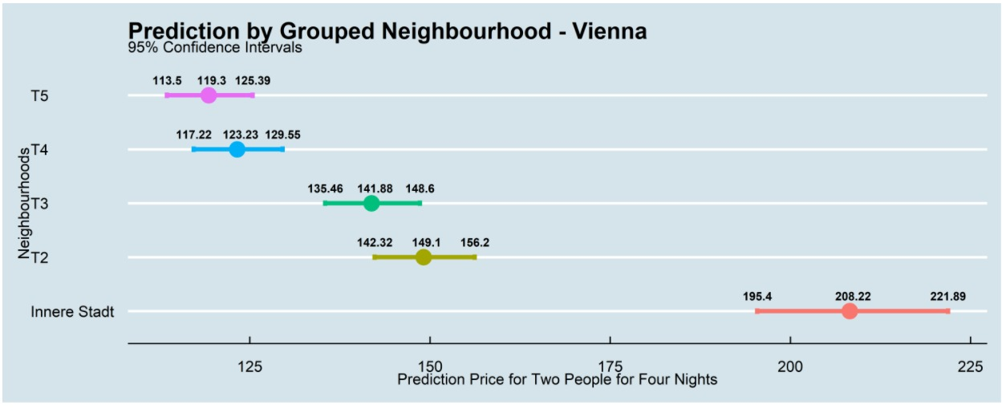
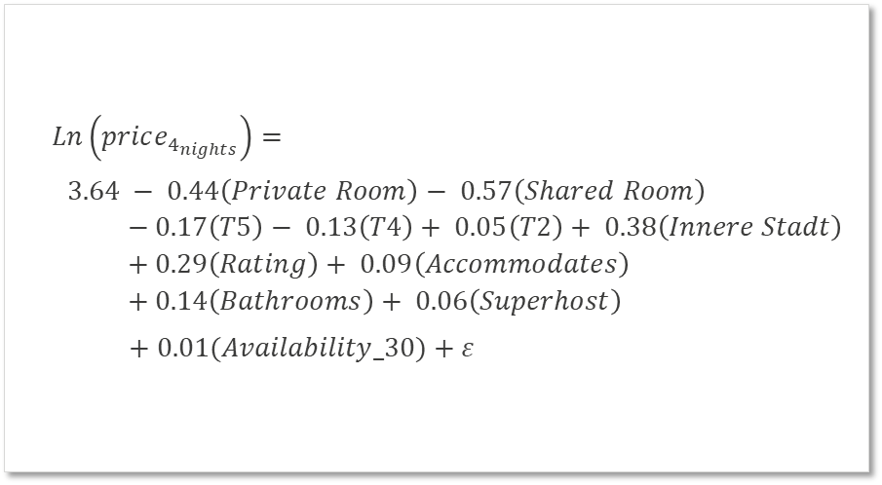
Predictions Based on the Best Model
Model Formula
Prediction Results
$$Ln\left(price_{4_{nights}}\right)=$$
$3.64 − 0.44\left(Private Room\right)− 0.57\left(Shared Room\right)$
$$− 0.17\left(T5\right)− 0.13\left(T4\right)+ 0.05\left(T2\right)+ 0.38\left(Innere Stadt\right)$$
$$+ 0.29\left(Rating\right)+ 0.09\left(Accommodates\right)$$
$$+ 0.14\left(Bathrooms\right)+ 0.06\left(Superhost\right)$$
$+ 0.01(Availability_30)+ε$
How to use our model?
Exponential of the model result gives the predicted price for 2 people and 4 nights based on our best model
Prediction plot
From the prediction plot of price in different neighbourhoods, our model gives prediction results similar to actual values
This model illustrates its prediction power in Vienna

